Slide 1
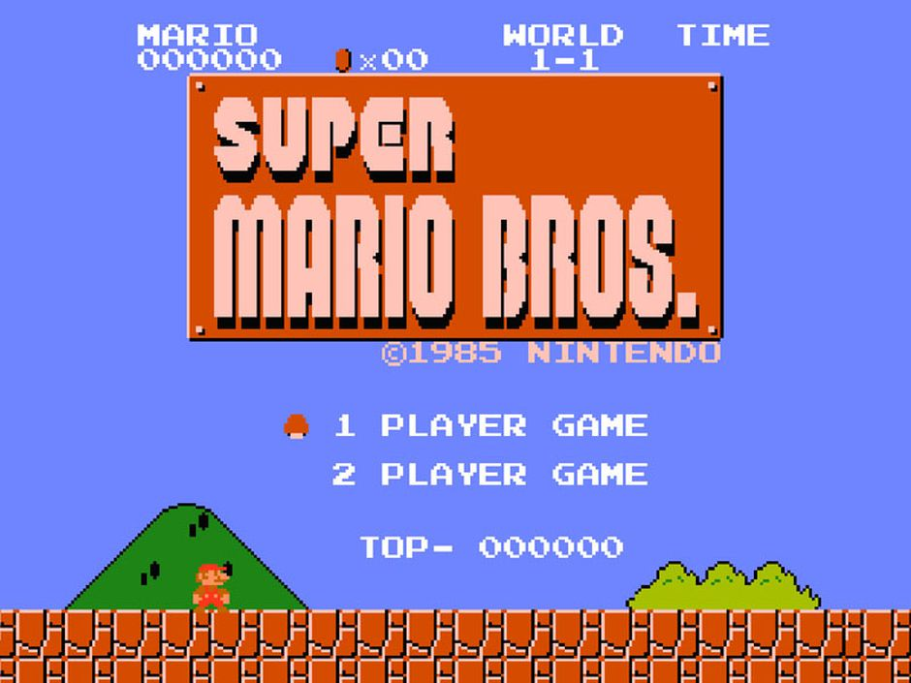
Analyzing The Code to
Written by Jaelen Cole
With Analysis by Angel Rinos, Ali Raza, and Amarinder Singh

Slide 2
Introduction
One day, while browsing the internet for personal research, I found a source code for Super Mario Bros. that compiles the game in the format of C/C++. It can be accessed and viewed easily through visual studio.
Initially, I downloaded it for ulterior reasons, but since we had a project on bitcoin (or anything that involves computer science) to do for this class, I wondered if it could be used as an analysis for our studies.
So, I’ve banned together with three other classmates to look over and analyze this source code. These are our findings...

Slide 3
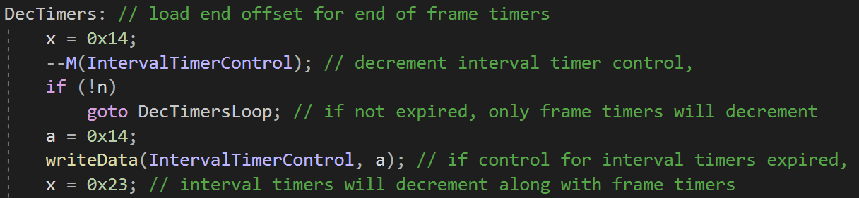
The Mario Project itself has been mixed with different sources of code which revolve around C++ and ARMS assembly.
Most of the codes have unique functions on how the program itself was able to produce the frames of the game.
An example would be like how the project functions for a timer.
The variable DecTimers makes it to where the timing of each frame is played in the game.

Slide 4
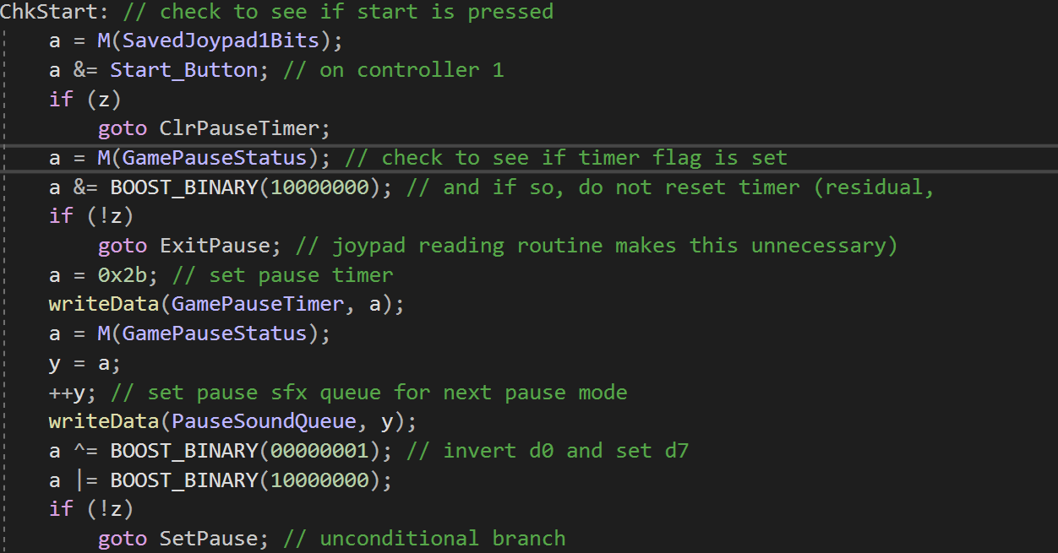
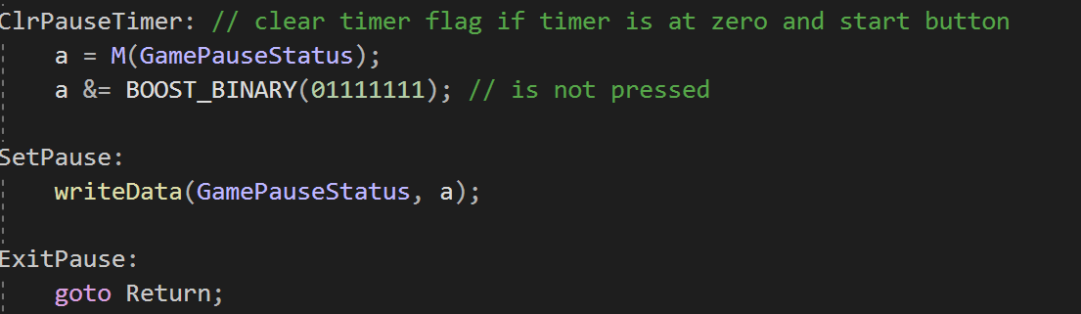
Another example is how to check if the game starts...
This function itself provides when the game starts and when it will pause the moment a player pauses the game.
An interesting variable from this section is ClrPauseTimer, as when the level finishes, the program would stop the timer if the player reaches the flag.

Slide 5
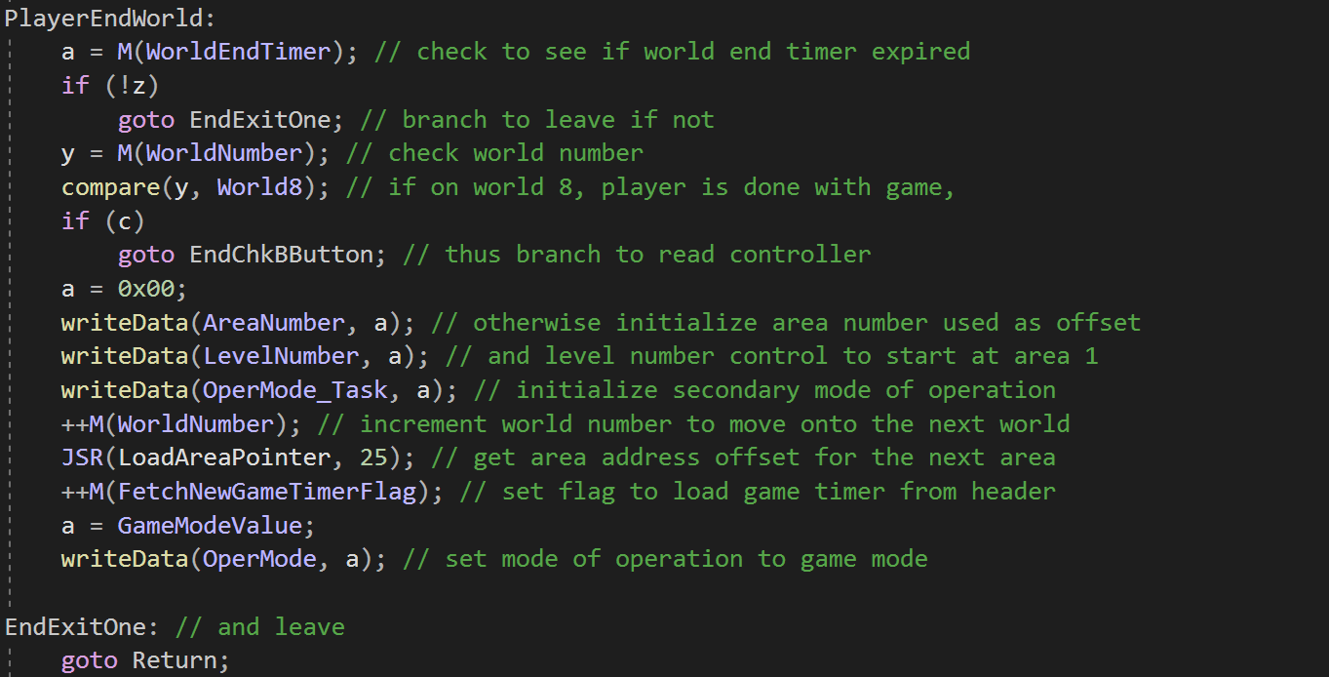
The following code checks when to end the world. Weather the player wins or loses. Or if the timer runs out, then it ends the world too. Also, on world 8 if the player beat the game the world ends.
If player loses it goes to the returns statement and ends the game.

Slide 6
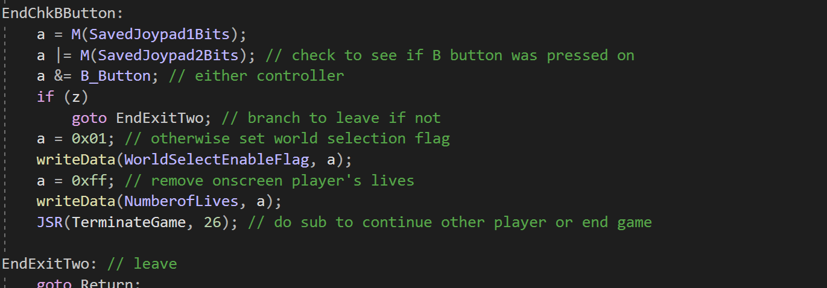
This part of the code checks if the player wants to quit. OR if the person doesn’t want to quit it
continues on.

Slide 7
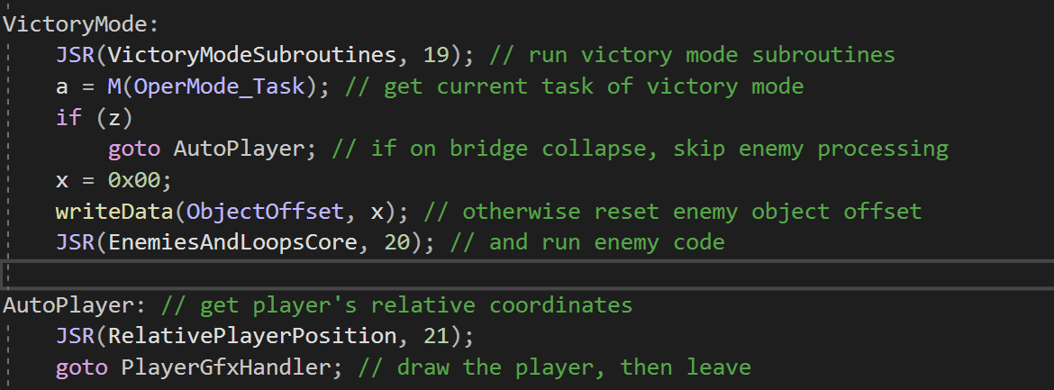
This segment is part of the most important lines of code as it transitions from one round to another. If a person is on the right coordinates the game would allow them to battle the enemy and if won they will be transferred to the second round. This code also stops the character from moving once victory has been achieved.

Slide 8
Conclusion
As you can see, there are many intricacies as to how one of the greatest video games of all time functions.
But we’ve barely even scratched the surface on the mechanics and variables that were coded into this now over 35-year-old game.
If you are curious about the code yourself, You can view the code yourself by downloading it on the next slide.
But regardless, we hope you enjoyed our brief analysis of the code to Super Mario Bros.

Slide 9
Source Code
https://github.com/MitchellSternke/SuperMarioBros-C

